Slide 1
Table 1. Description of historical and sensor data
Variable | Units | Instrument | Duration | Resolution | Data latency | Use in model
Discharge | m³/s | WVWA | 2013-present | 10 minutes | Weekly to monthly | Weekly training
Discharge | m³/s | Name of new PT | 2019-present | 10 minutes | Daily? | Weekly forecasts
Surface Chlorophyll-a | µg/L | CTD Seabird | 2013-present | Weekly | Weekly | Weekly and daily training
Surface Chlorophyll-a | µg/L | EXO-Sonde | August 2018-present | 15 minutes | 4 hours | Weekly and daily forecasts
Shortwave radiation |  | VT met station | ??-present | 10 minutes | Daily | Weekly training
NOAA Ensemble Shortwave Forecasts |  | N/A | N/A | 3 hours | Daily | Weekly forecasts
Relative humidity |  | VT met station | ??-present | 10 minutes | Daily | Daily training
NOAA Ensemble Relative Humidity Forecasts |  | N/A | N/A | 3 hours | Daily | Daily forecasts
Notes:
Finish filling this out

Slide 2
Lucid chart

Slide 3
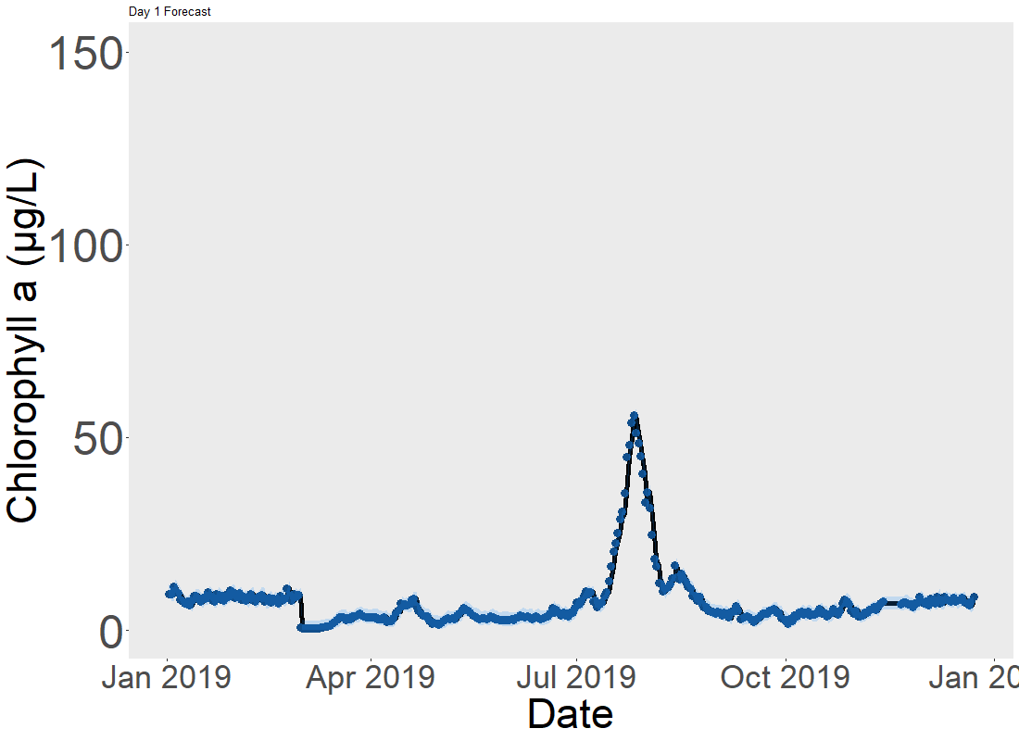
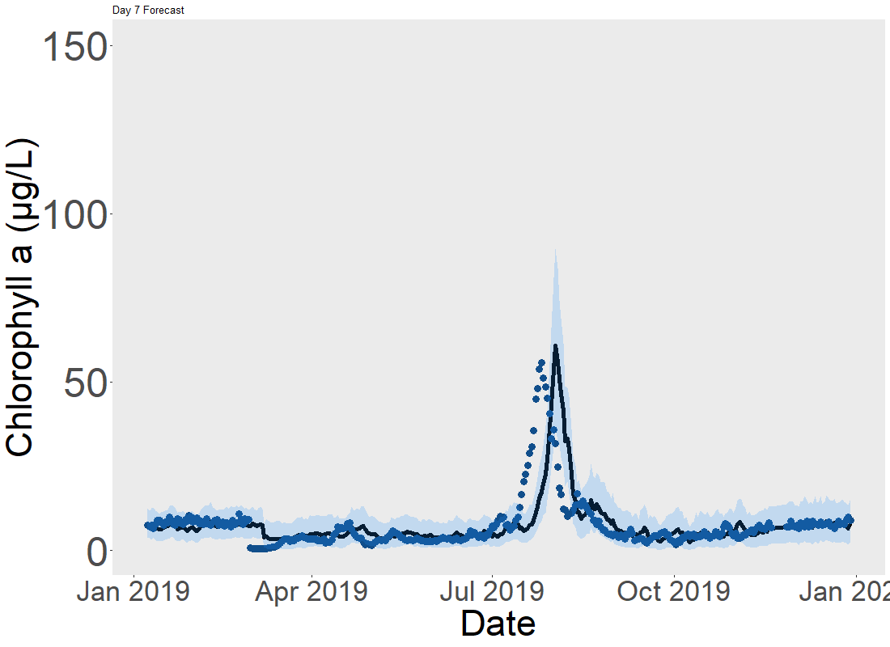

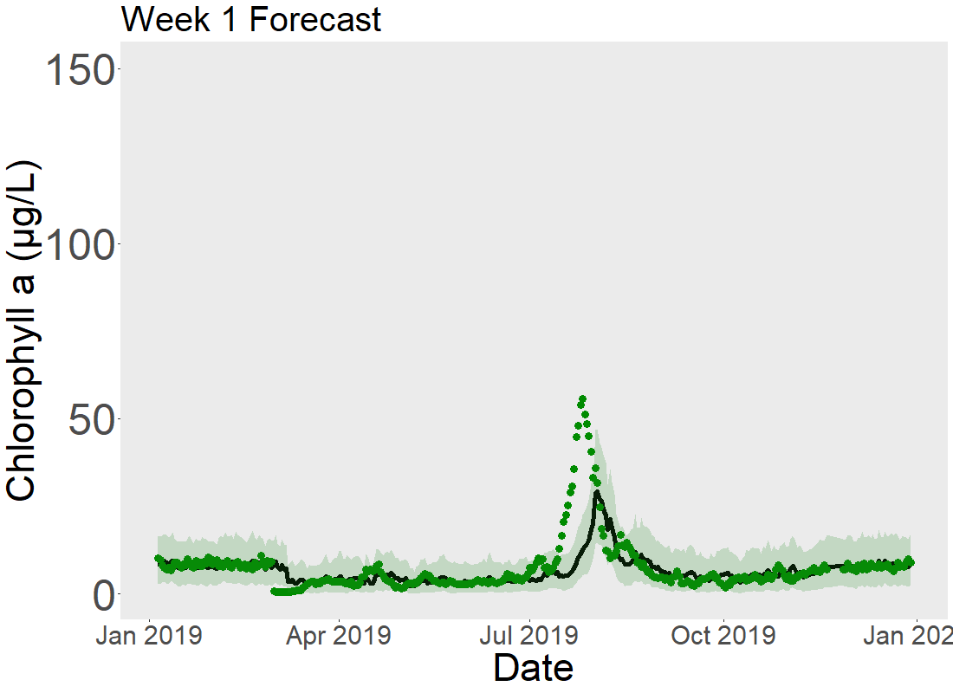
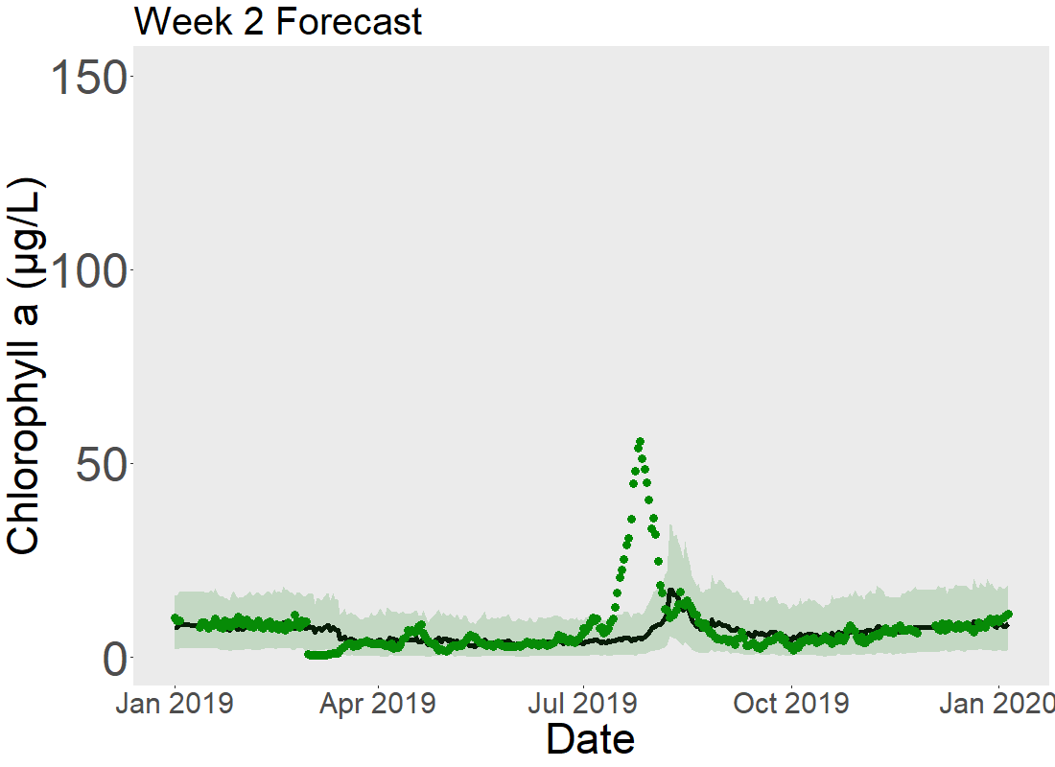
LEGEND HERE
Figure 3. Forecasted and observed chlorophyll-a over one year in a) daily forecasts at 1 day, b) daily forecasts at 7 days, c) daily forecasts at 14 days, d) weekly forecasts at 7 days, and e) weekly forecasts at 14 days. Green dots represent observed chlorophyll-a, black lines show the mean of 420 forecast ensembles, and the light green shaded area gives the 95% confidence intervals of the forecast ensembles.
Notes:
LEGEND
Decide between fixed y axis or not

Slide 4
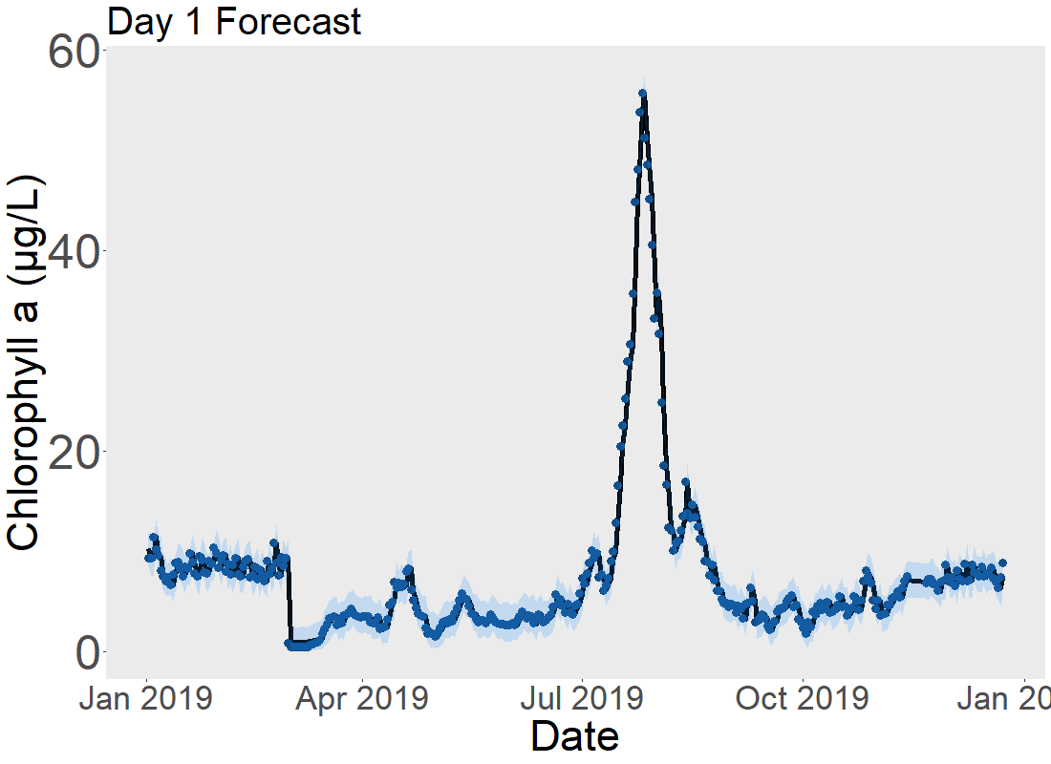
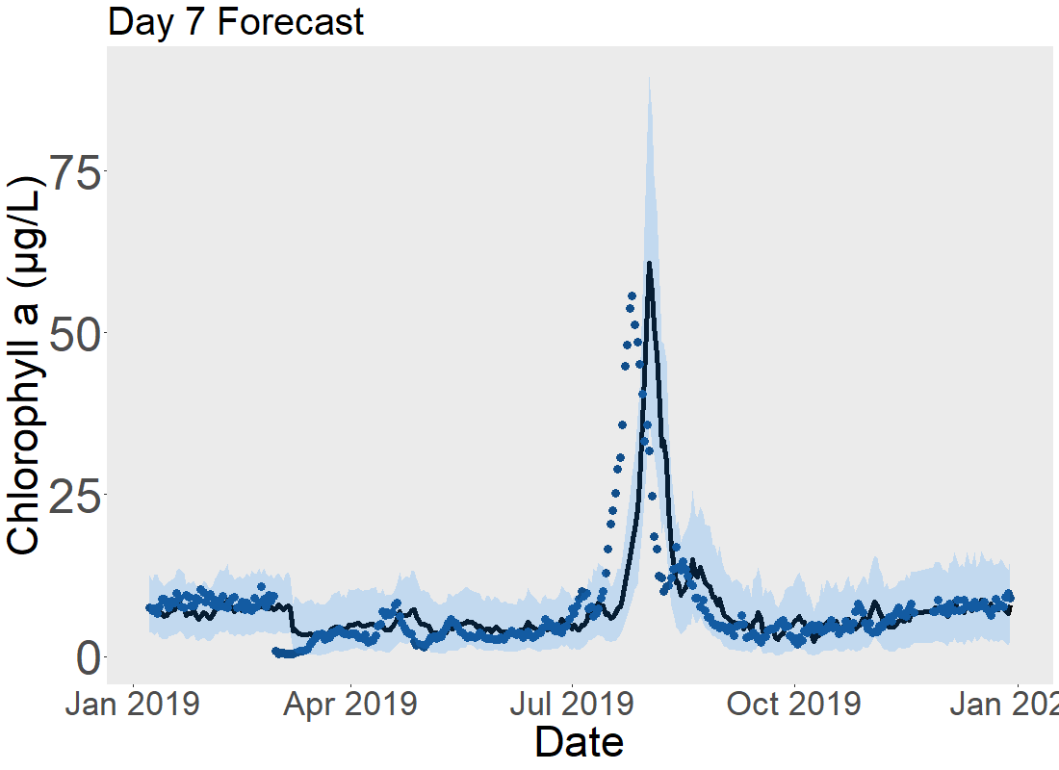
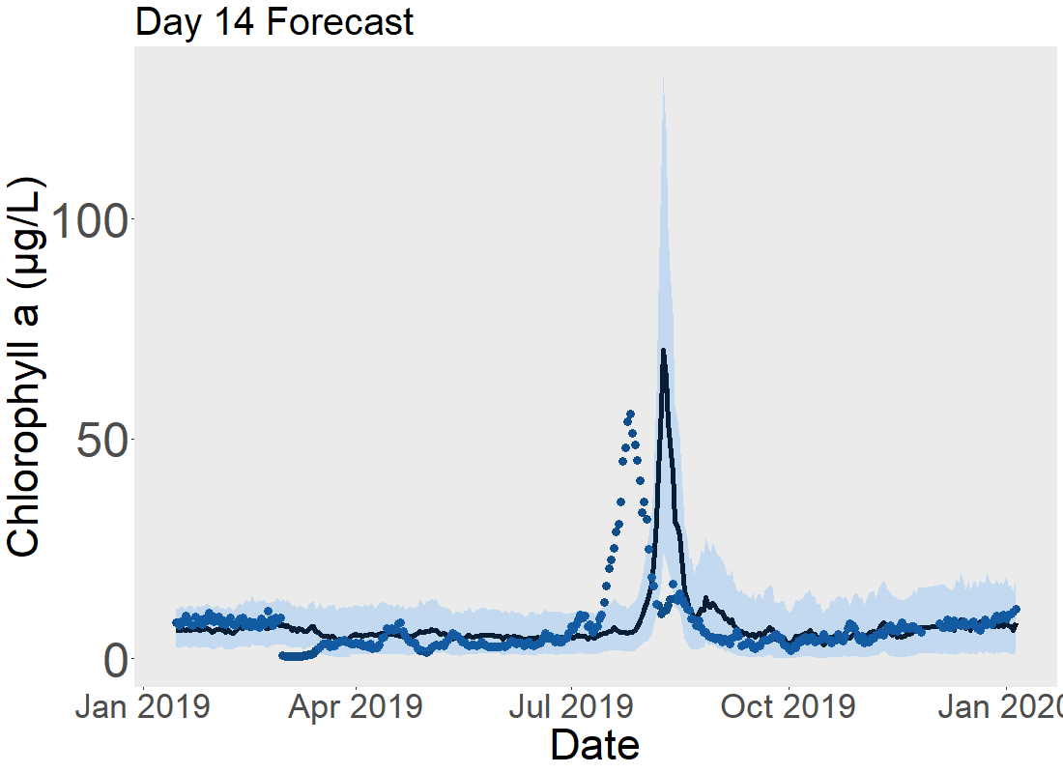
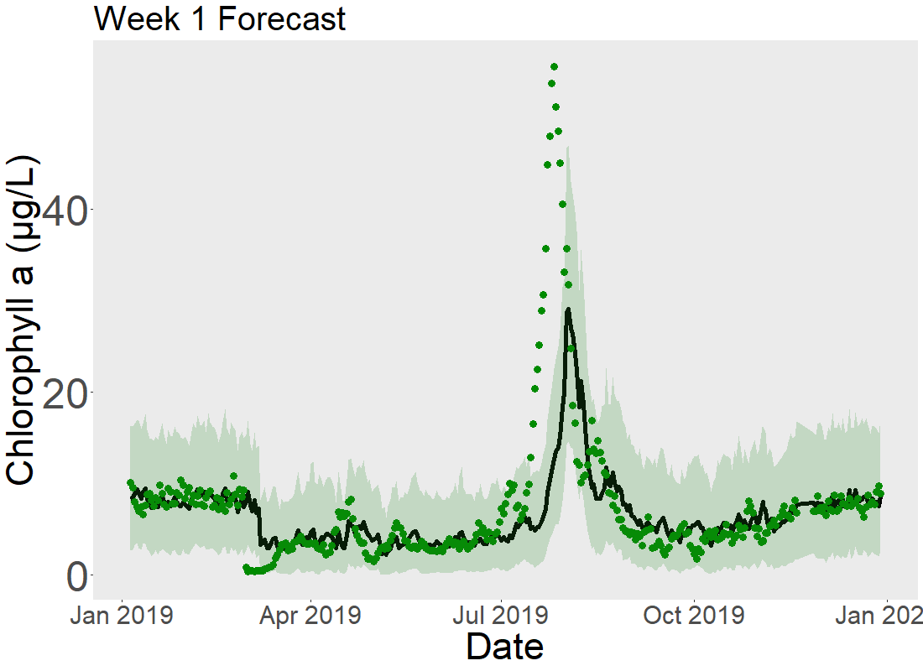
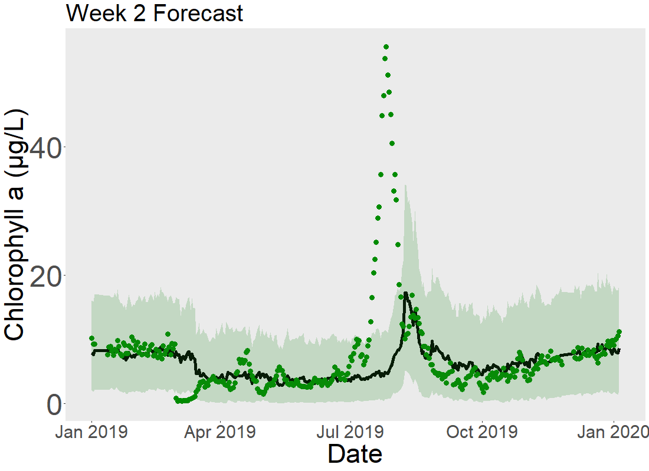
Notes:
Same as slide before, but with moving y axis, decide between these two

Slide 5
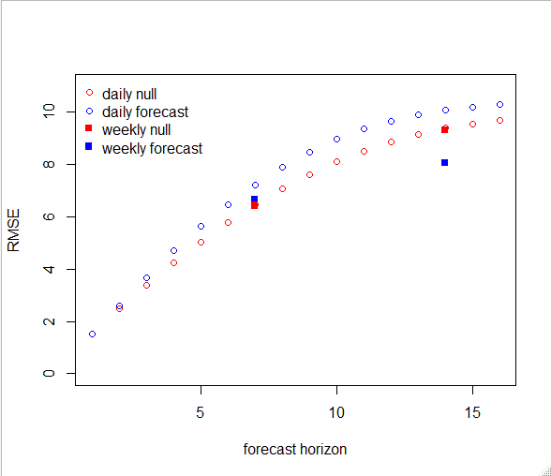
Figure 4. RMSE of forecasts across forecast horizon
Notes:
Might remake these in ggplot for consistency with other figures
Panel with weekly vs daily and a different panel with nonbloom and bloom (this will emphasize the point that bloom and nonbloom are very different)

Slide 6
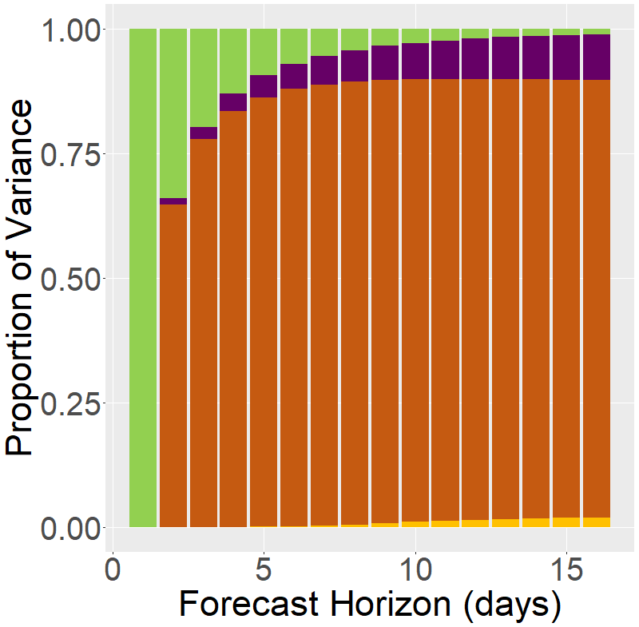
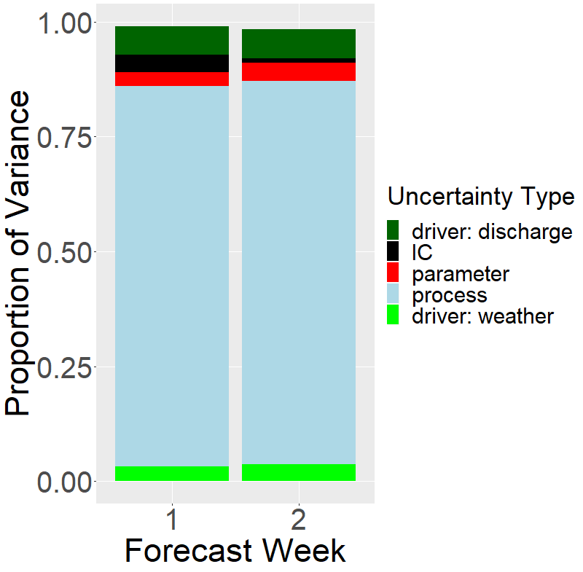
Notes:
Make colors the same for weekly. Some way to highlight day 7 and 14 for daily forecasts to ease comparison
LEGEND
Could make plot with total variance instead of proportion of variance

Slide 7
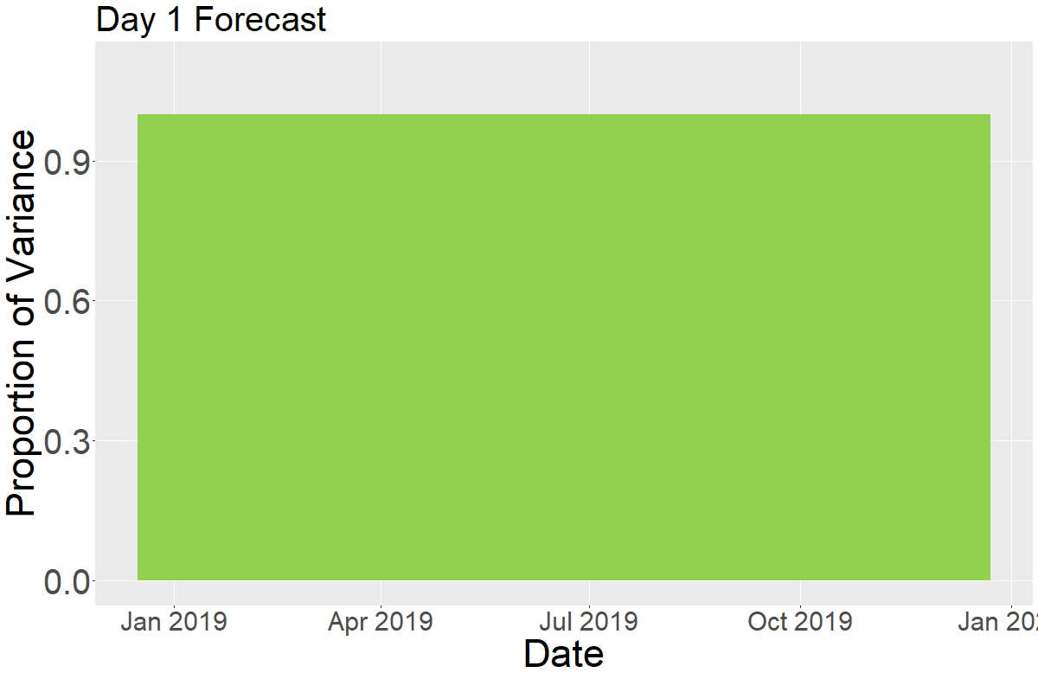
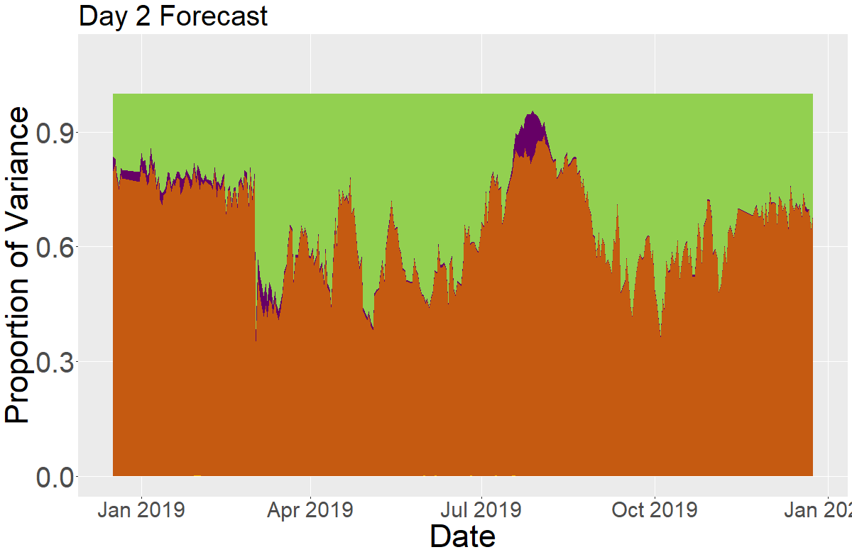
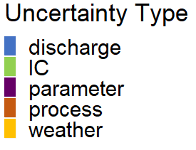
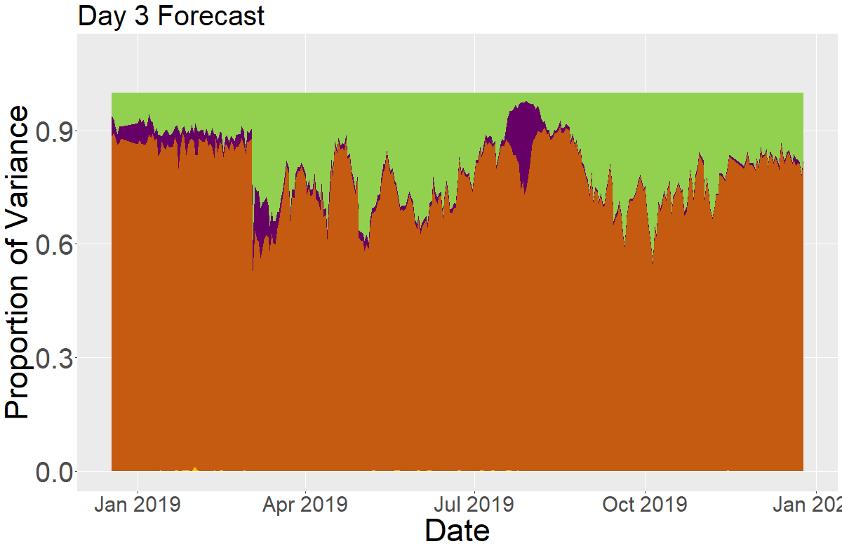
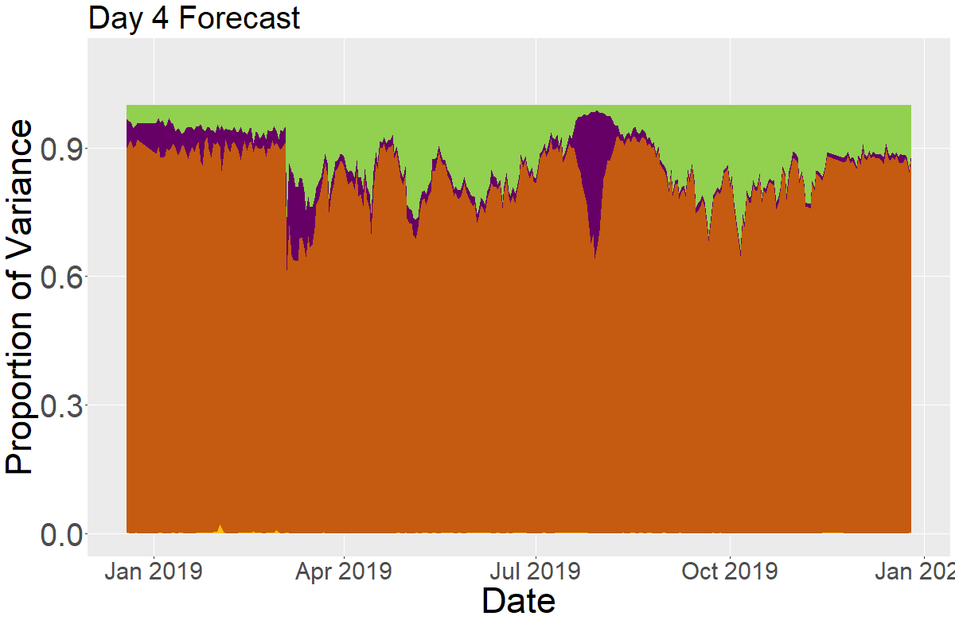
Notes:
Green = IC
Purple = parameter
Orange = process

Slide 8
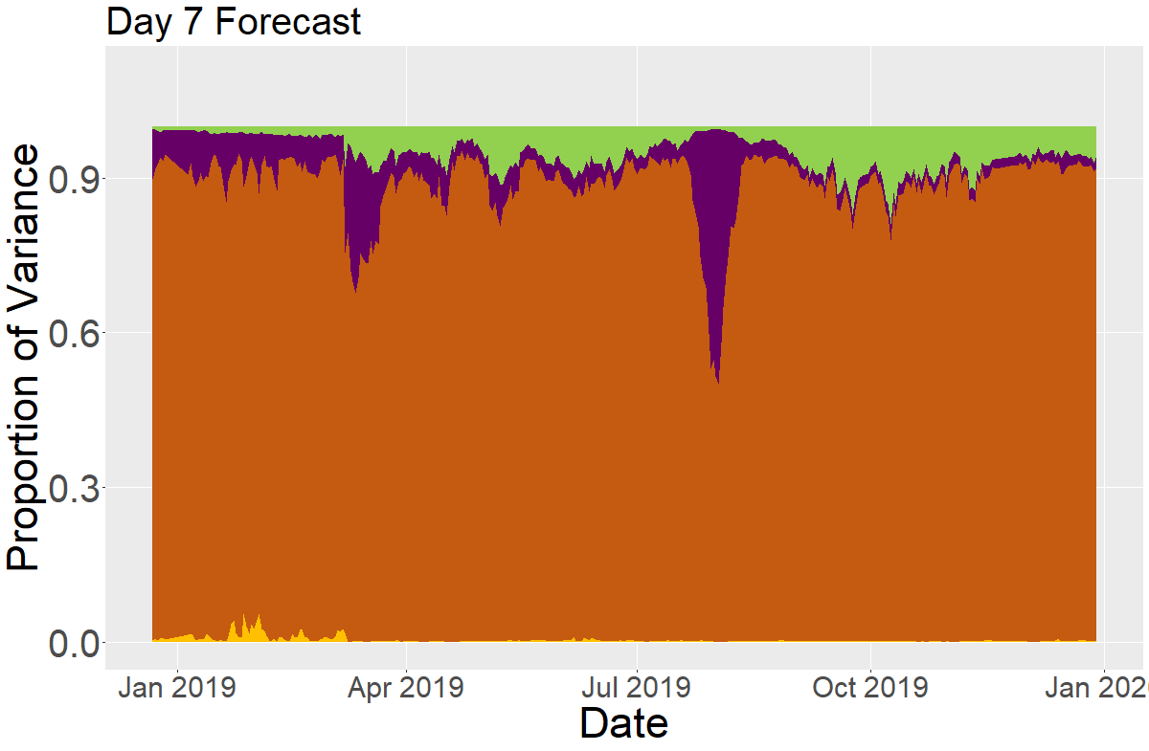
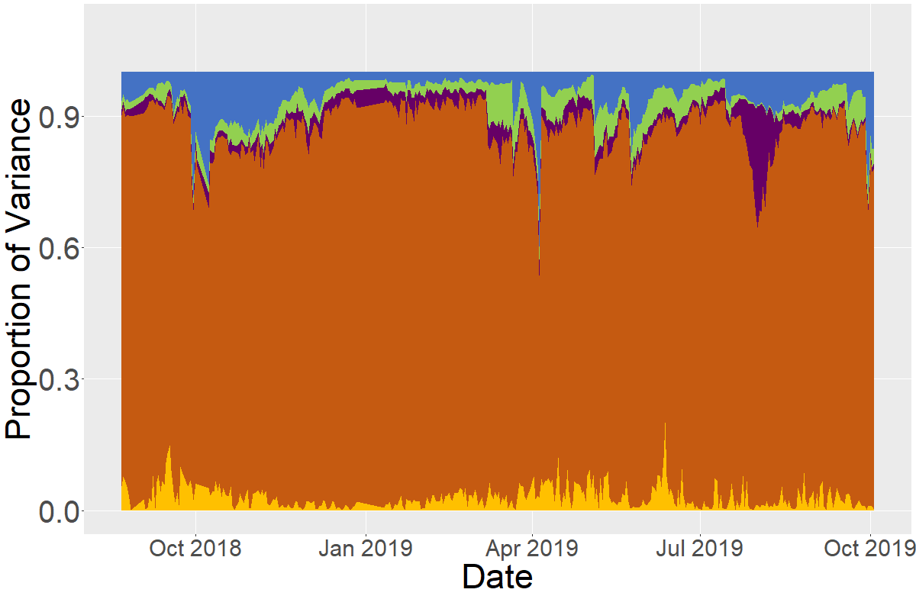
Week 1 Forecast
Figure 5. Relative proportion of uncertainty over one year for a) daily forecasts at 7 day forecast horizon and b) weekly forecasts at 1 week
Notes:
Re-run weekly model for jan 19 – jan 20
LEGEND

Slide 9
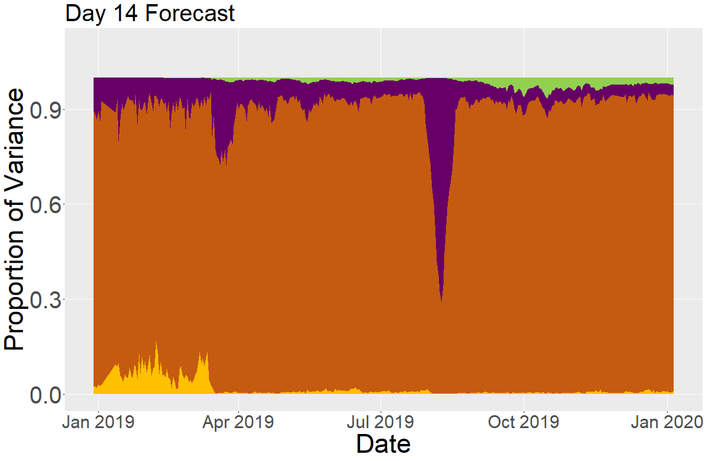
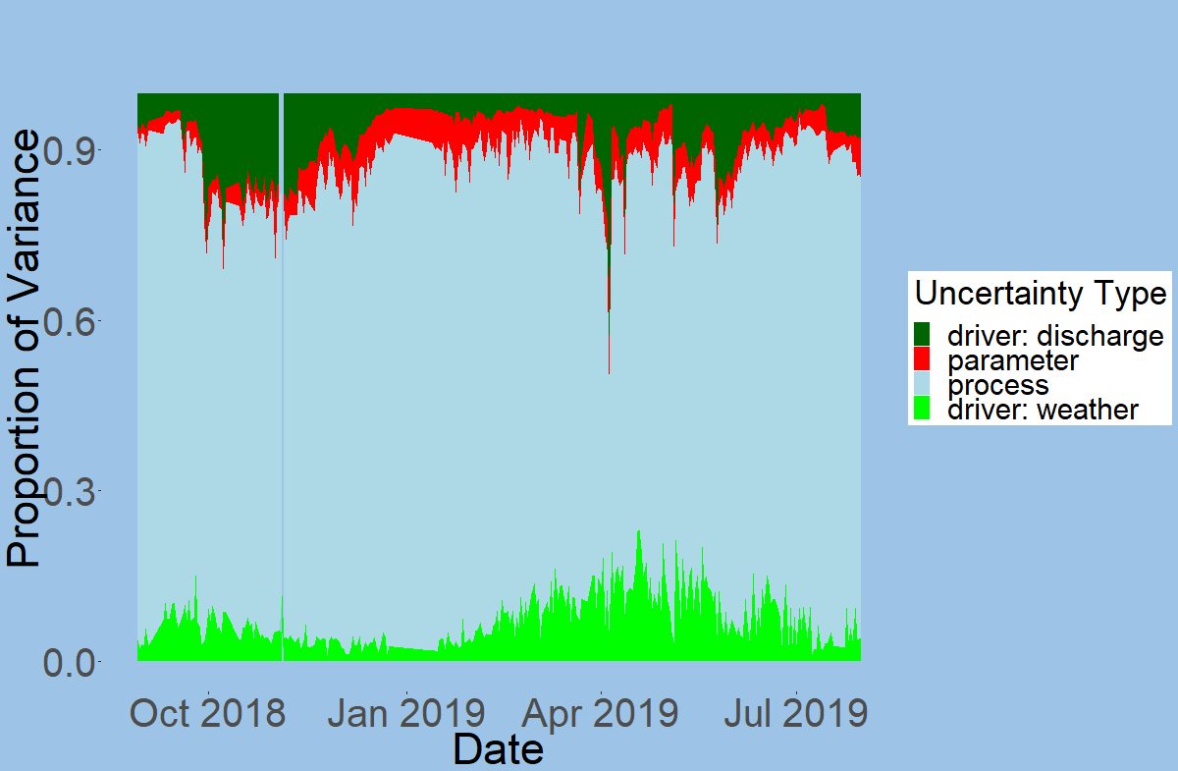
Notes:
Remake week 2 with proper colors and with updated data (jan 19- jan20)
LEGEND

Slide 10
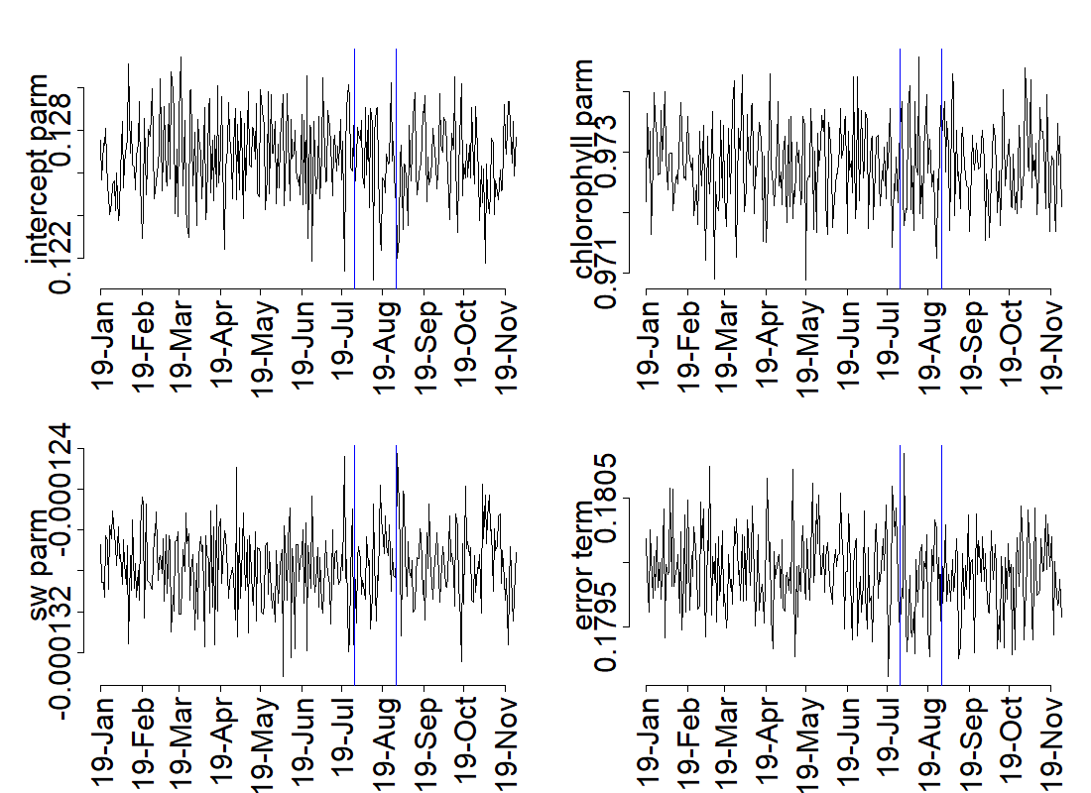
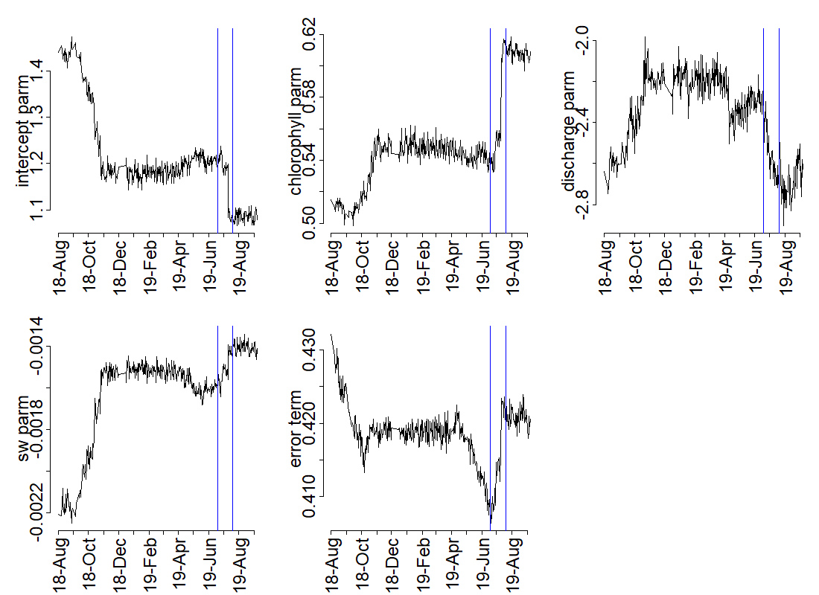
Figure S1. Time series of parameter evolution over forecast period.
Notes:
DISCLAIMER: these are the parameters for the older daily model. Need to recreate for relative humidity model

Slide 11
Supplemental of all potential driver variables
Would include all the met variables that weren’t chosen and the other summary stats (e.g., the median, min, max values that didn’t make it into final model)

Slide 12
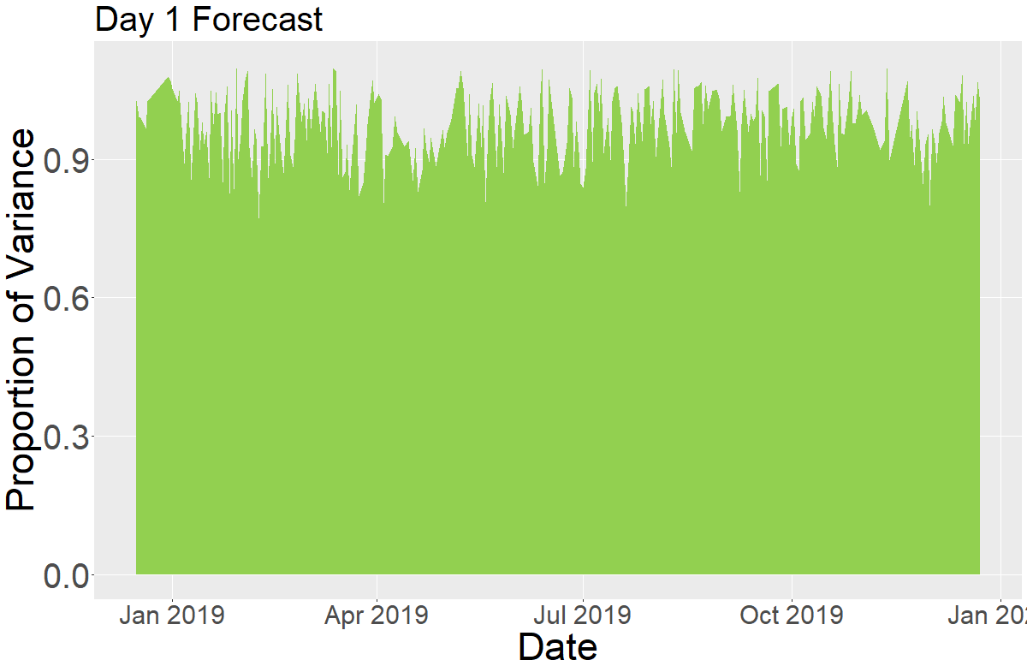
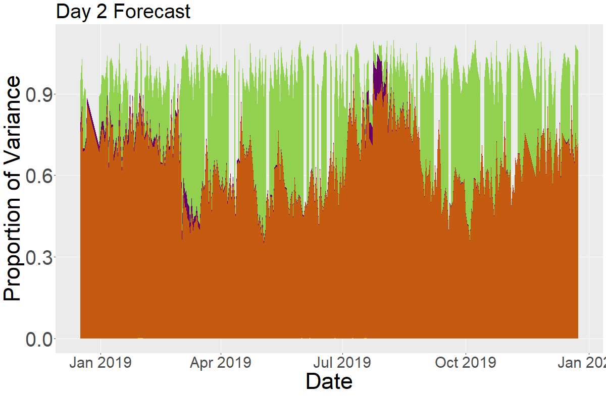

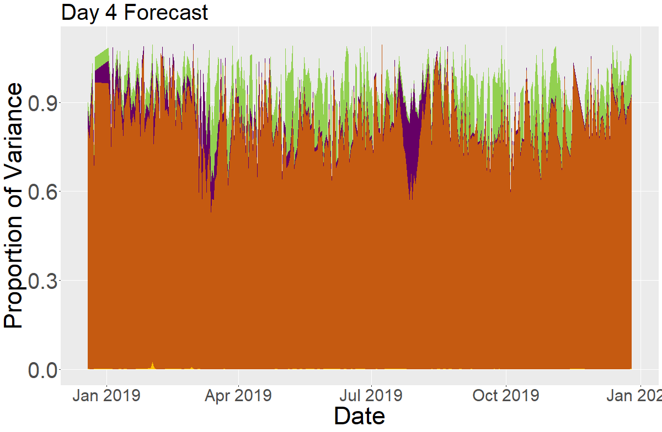
Notes:
LEGEND, proportions calculated over total forecast_variance so not always adding up to 100%

